Slide 1

PROJECT PHASE -1 Presentation on IOT Based Smart Garbage Monitoring system and Domestic Care. M.PRAMOD KUMAR 204E5A0212 N.DENNESWAR 204E5A0203 G.HEMANTH 204E5A0207 K.RAVINDRA 204E5A0216 SIDDARTHA INSTITUTE OF SCIENCE AND TECHNOLOGY (AUTONOMUS) DEPARTMENT OF ELECTRICAL AND ELECTRONICS ENGINEERING Under guidance of Dr. N.BALAVENKATA MUNI, M.Tech., Ph.D Professor Department of EEE.

Slide 2
PRESENTATION OUTLINE
INTRODUCTION
LITERATURE REVIEW
DATA COLLECTION
OBJECTIVES
EXISTING SYSTEM
PERSPECTIVE
COMPONENTS
APPLICATIONS
EXPECTING RESULTS

Slide 3

INTRODUCTION--
As the population increases the cleanliness also decreases. In the metropolitan city, more diseases have spread the problem of garbage waste.
The development of smart cities needs a smart garbage monitoring system. So the garbage waste management system plays a major problem in the global world.
The garbage monitoring system is succeeding with smart bins. We develop the smart bins and it is connected to the dashboard and it can be accessed anywhere.
Our smart bins is implemented using IoT, cloud technology and data science. IoT is used for hardware progress on the devices and cloud is used for storing the data.

Slide 4
LITERATURE REVIEW--
Prof. R.M.Sahu, Akshay Godase, Pramod Shinde, Reshma Shinde,” Garbage and Street Light Monitoring System Using Internet of Things” INTERNATIONAL JOURNAL OF INNOVATIVE RESEARCH IN ELECTRICAL, ELECTRONICS, INSTRUMENTATION AND CONTROL ENGINEERING, ISSN (Online) 2321 – 2004, Vol. 4, Issue 4, April 2016.
Kanchan Mahajan, Prof.J.S.Chitode, “Waste Bin Monitoring System Using Integrated Technologies”, International Journal of Innovative Research in Science, Engineering and Technology (An ISO 3297: 2007 Certified Organization) Vol. 3, Issue 7, July 2015.
Md. Shafiqul Islam, M.A. Hannan, Maher Arebey , Hasan Basri ,“An Overview For Solid Waste Bin Monitoring System”, Journal of Applied Sciences Research, ISSN 181-544X, vol.5,lssue4, February 2012

Slide 5
Thangavel Bhuvaneswari ,” Internet of things (IoT) based Smart Garbage monitoring system”, Indonesian Journal of Electrical Engineering and Computer Science Vol. 20, No.2, November2020.

Slide 6

DATA COLLECTION--
9 Out of 10 People are Breathing polluted air caused by Garbage waste..
7 million people every year caused by ambient (outdoor) and household air pollution.
WHO estimates that around 7 million people die every year from exposure to fine particles in polluted air that penetrate deep into the lungs and cardiovascular system.
Causing Diseases Like, Trimethylaminuria.
Caused by unpleasant smell,That can effect Breath.

Slide 7

OBJECTIVES
This project introduces the design and implementation of garbage monitoring by measuring the garbage level in real time and to alert the municipality whenever the bin is full.
To separate or more precisely segregate the waste into two types wet and dry waste, based on the moisture content present in the waste

Slide 8
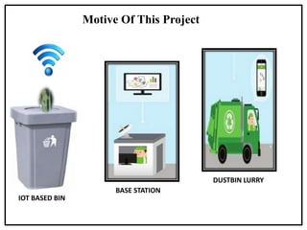

Slide 9

EXISTING SYSTEMS--
In the existing system, garbage bins are manually managed.
It needs human effort to check every time.
Monitoring and management of wastes is one of the primary issues in the cities.
Draw backs of the system:
It sends message only when bin is filled.
There is no monitoring is presented.
Time consuming and less effective
It purely depends upon only weight
Bad smell spreads and may cause illness to human beings
High cost

Slide 10
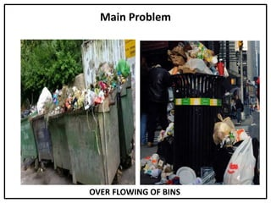

Slide 11

PERSPECTIVE--
In the system we have automated this process. Here we are using ultrasonic sensors which are fixed over the dustbins. Soil Moisture to detect the wet and dry waste dust.
When waste is filled in the bins the distance will be decreased between the waste and sensors. Every time it will check the level and calculates the distance.
This live data is sent to Arduino. Arduino will process the data and send to the cloud server through WIFI Module.
Through this webpage the user can access the data and plan according to that; which bin needs attention and certain action will be taken to clean the bins.

Slide 12
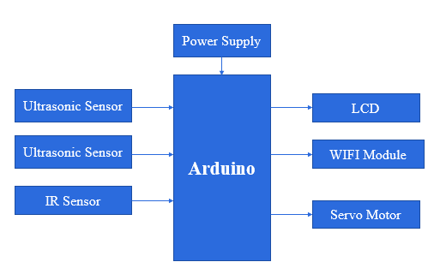
BLOCK DIAGRAM OF PROPOSED SYSTEM-

Slide 13
COMPONENTS
ARDUINO
IR SENSOR
SOIL MOISTURE
ULTRASONIC SENSOR
ESP8260 WIFI
LCD
MALE -FEMALE WIRES
SERVO MOTOR
POWER ADAPTER

Slide 14
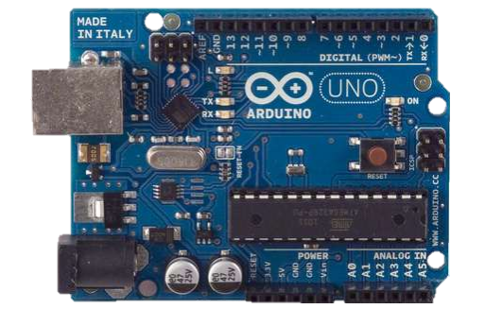
ARDUINO UNO R3-
Programming to “Node MCU ESP32’’
using ARDUINO IDE software
Using code in C/C++ Language.
Connecting ESP32 to PC through, micro usb and upload the code …
Arduino IDE where IDE stands for Integrated Development Environment – An official software introduced by Arduino.cc,
That is mainly used for writing, compiling and uploading the code in the Arduino Device.

Slide 15
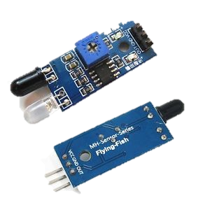
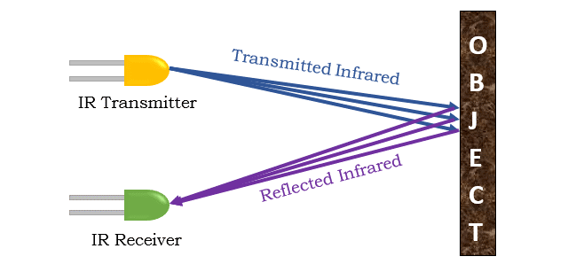
IR SENSOR-
An infrared sensor is an electronic device, which emits in order to sense some aspects of the surroundings.
Operating voltage is 5v ,Input voltage is 7-12v,Measuring range is 2-30cm ,weight—5gm
An IR sensor can measure the heat of an object as well as detects the motion.
Working-

Slide 16
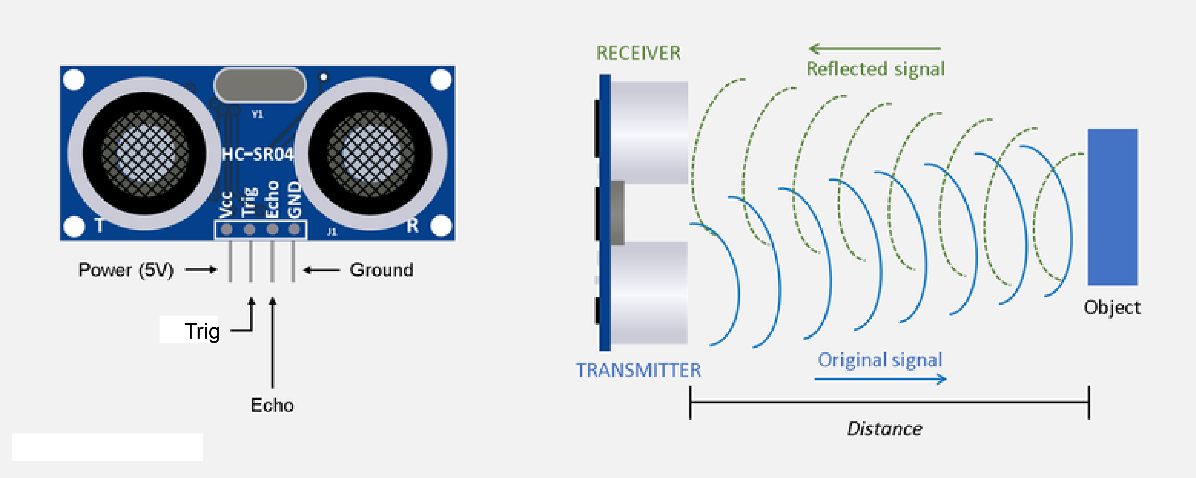
ULTRASONIC SENSOR-
An ultrasonic sensor is an electronic device that measures the distance of a target object by emitting ultrasonic sound waves, and converts the reflected sound into an electrical signal.
Ultrasonic sensors have two main components: the transmitter (which emits the sound using piezoelectric crystals) and the receiver (which encounters the sound after it has travelled to and from the target).

Slide 17
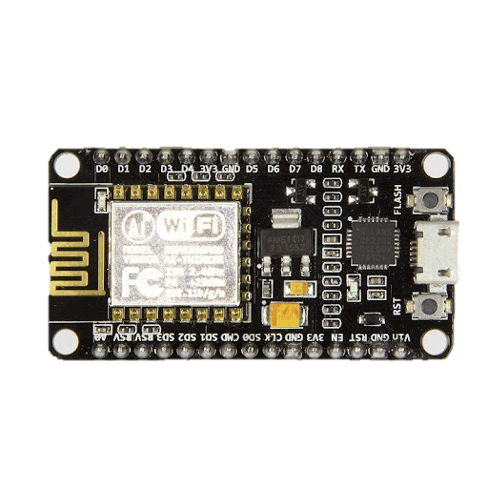
NODE MCU-
Node MCU is an open-source firmware and development kit that plays a vital role in designing your own IoT product using a few Lua script lines
ESP32 NODE MCU are more and more used to make connected objects thanks to make their embedded wifi and bluetooth links and their computing Power.
Multiple GPIO pins on the board allow you to connect the board with other peripherals and are capable of generating PWM, I2C, SPI, and UART serial communications

Slide 18
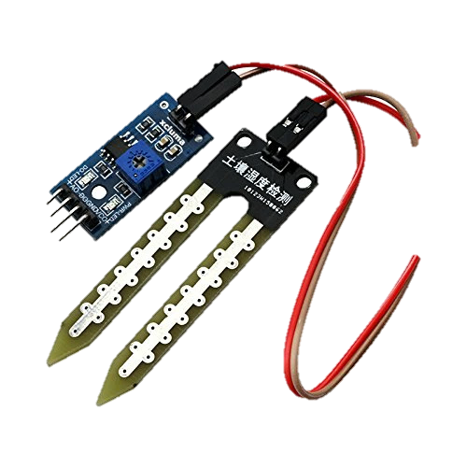
MOISTURE SENSOR-
It Measures the Humidity of the Compost
It is recommended to power the sensor with between 3.3V – 5V output will vary depending on what voltage is provided for the sensor

Slide 19
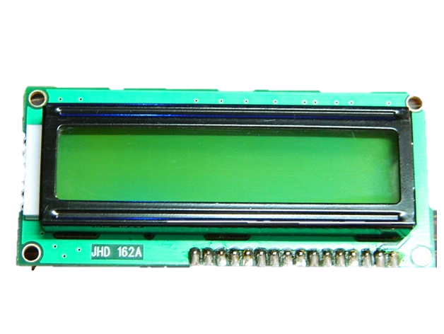
LCD :
Liquid Crystal Display
It Shows the GARBAGE status.

Slide 20
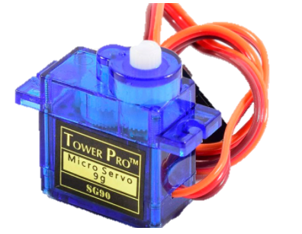
SERVO MOTOR :
A servomotor (or servo motor) is a simple electric motor,
controlled with the help of servomechanism.
It runs on 5v and can rotate 180 degree i.e 90 in each
direction.

Slide 21
APPLICATIONS
Empowered Swatch Bharat Mission
Support Digital India
Real time based Monitoring waste collection
It makes our system transparent between Municipal Corporation ,Workers and public.

Slide 22
EXPECTING RESULTS--
The garbage system needs to be cleaned when it is filled to maintain a hygienic environment.
Our smart garbage collection system contains WIFI Module, Ultrasonic sensor, IR Sensor and Thing speak Cloud.
The system monitor the garbage level and it reaches the particular level it sends the notification. This notification system helps the municipality to monitor the garbage wastes.
Our model overcomes the entire problem in smart garbage system monitoring.
The developed system provides Improved database garbage collection time and quantity of garbage at each Location.
By Implementing this project we will avoid overflow garbage in residential area.
Development of application for city Administration ,Municipal staff…

Slide 23

THANK YOU…

